Slide 1



About myself
My name is Landon Moon
I am majoring in Computer Science
I transferred to UTA this semester
I have a similar amount of credit hours to a sophomore.

Slide 2
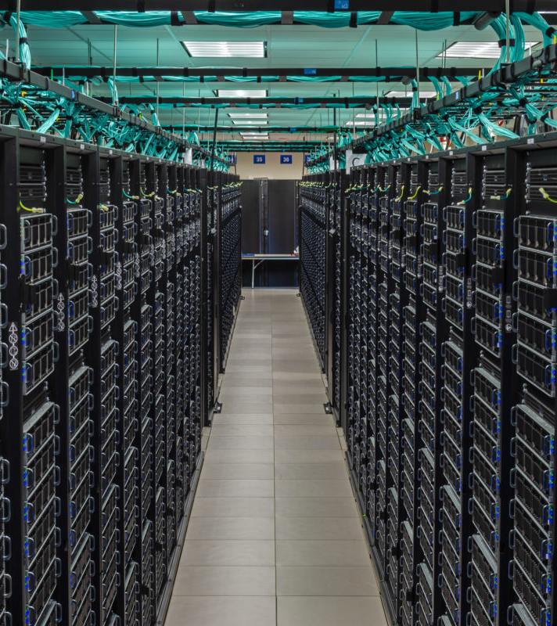
Supercomputers in the fields of ENGR
Civil Engineering
Computer Science
Electrical Engineering
Industrial Engineering
Mechanical Engineering
Industrial Engineering
Mechanical Engineering
Civil Engineering

Slide 3
Supercomputers in the fields of Engineering
Civil Engineering: Supercomputers are housed in large buildings that require planning and design by a civil engineer. Keeping the building secure and safe are very important to keeping the supercomputer operational.
Computer Science: Supercomputers run software in order to compute their calculations. This software is designed by computer scientists. Computer scientist also use supercomputers in order to run calculations with their software.
Electrical Engineering: Supercomputers are built out of thousands of parts made up of wires. On the low-level parts such as power supplies and motherboards, electrical engineers are there to make sure the system doesn’t fry itself.

Slide 4
Supercomputers in the fields of Engineering CONT.
Industrial Engineering: Supercomputers need to be the most efficient as possible with heat, electricity, and of course computing. These types of problems are usually
Mechanical Engineering: supercomputers usually have coolant going through the system to make sure everything stays cool. The calculations to determine how much coolant and how fast the heat needs to be dissipated will be done by a mechanical engineer.

Slide 5
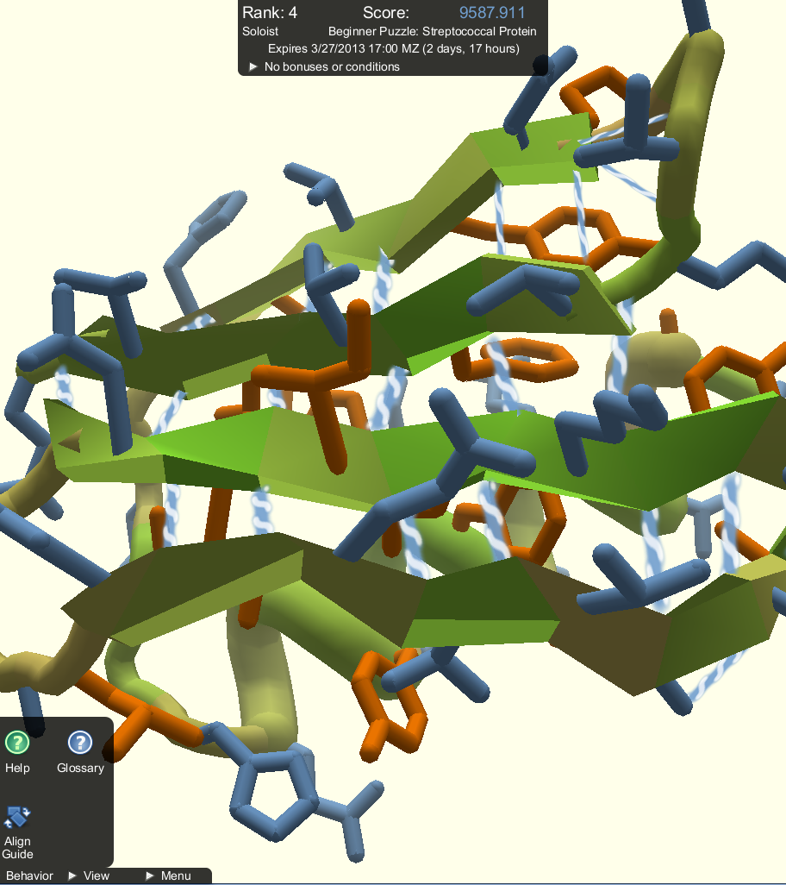
Protein folding in the fields of ENGR
Biomedical Engineering
Computer Science
Biomedical Engineering
Computer Science

Slide 6
Protein folding in the fields of ENGR
Biomedical Engineering: biomedical engineers use protein folding to determine what certain configurations of amino acids will do.
Computer Science: The program to run protein folding simulations must be designed, and built by computer programmers. These programmers would probably work along the biomedical engineers in order to properly code the program.

Slide 7
Reflection on the fields of engineering
Engineers are trained to make things work and to solve problems
While each engineering field has specific job it is designed to do, each job usually required multiple fields.
For example a civil engineer helped design the buildings that can be used from anything from research to producing power.
No one type of engineering is enough to fill every slot in a process. Everything requires teamwork.

